Slide 1
Lecture 6: Stochastic optimization EM algorithm

Slide 2
Stochastic and combinatorial optimization
Unconstrained optimization:
Input variables are continuous
Response is differentiable
We could apply Steepest descent, Newton, BFGS, CG
Now:
Variables can be discrete (scheduling problem, traveling salesman)
Outcome can be discrete, noisy (typical in statistics) or having multiple local minima

Slide 3
Stochastic and combinatorial optimization
Given set of states S, objective to minimize f(s), typically S is large.
Sometimes, exhaustive search is possible (shortest path algorithm)
Often exhaustive search is computationally expensive, sometimes NP-hard (traveling salesman)
Alternative – a solution (sometimes exact) can be obtained by stochastic methods (ex: simulated annealing, genetic algorithms)

Slide 4
Simulated annealing
Idea comes from physics (melted metal is being cooled)
Parameters:
Energy of the metal (decreasing, but not monotonic)
Temperature (decreasing)
How to find minimum energy (global one)?

Slide 5
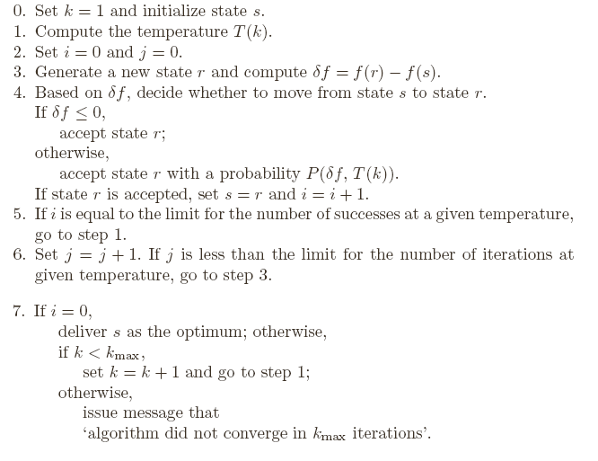
Simulated annealing

Slide 6

Simulated annealing
Comments
Check https://www.youtube.com/watch?v=iaq_Fpr4KZc
How to generate new state?
Continuous inputs: choose new point at some distance r from the current point (r can be a random variable..)
Discrete inputs: same idea or rearrangements
How to choose selection probability
Sometimes chosen as exp(-δf/T)
How to choose temperature function?
continuous or noisy functions, taken constant
Another choice

Slide 7

Simulated annealing
Example: Traveling salesman
Assume constant temperature
Choose initial configuration (A₁…A_{n})
Generate new configuration by 2-rearrangement:
Measure difference in path length δf between new and old configuration
If shorter path found, accept it otherwise accept it with probability P(δf)
Repeat until maximum iteration condition fulfilled

Slide 8
Genetic algorithm
Idea comes from biology (the fittest survives)
Variables=genotypes
Observation=organism, characterized by genetic code
State space= Population of organisms
Objective function=fitness of organism
New points are obtained from old points by crossover and mutation, the population retains only fittest organisms (with better objective function)

Slide 9
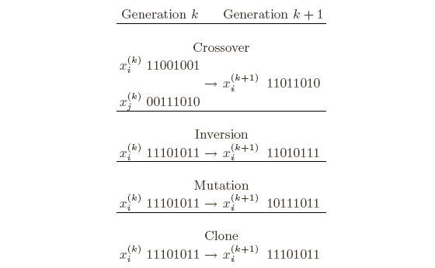
Genetic algorithm
How to code the points
Enumerate each point in S
Code for observation i is presented by binary representation of i
Other encodings are possible
Mutation and recombination rules

Slide 10
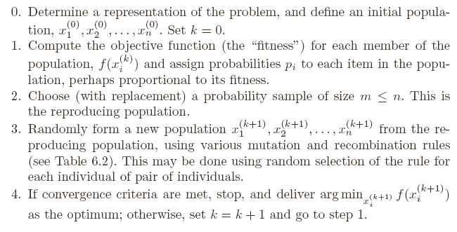
Genetic algorithm

Slide 11
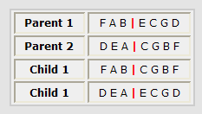
Genetic algorithm
Traveling salesman problem
Encoding and crossover
First idea - encode tours as A₁…A_{n.} Problem:
Instead: Remove FAB from DEACGBF -> DECG. Obtain first child by appending: FABDECG
Second child is obtained by taking prefix from parent 2

Slide 12
Genetic algorithm
Traveling salesman problem
Mutation
If taking small population and using only crossover – the input domain becomes limited, may converge to local solution
Taking large initial population may be computationally heavy
Mutation allows to investigate entire input domain
In traveling salesman, mutation =moving a city in the tour to another position

Slide 13
Genetic algorithm
Traveling salesman problem
Other issues
Reproduction: Among m tours selected at step 2, two best are selected for reproduction, two worst replaced by children
Neighborhood size: large m – some tours are never parents, global solution may not be attained
Mutation probalility should be fixed

Slide 14
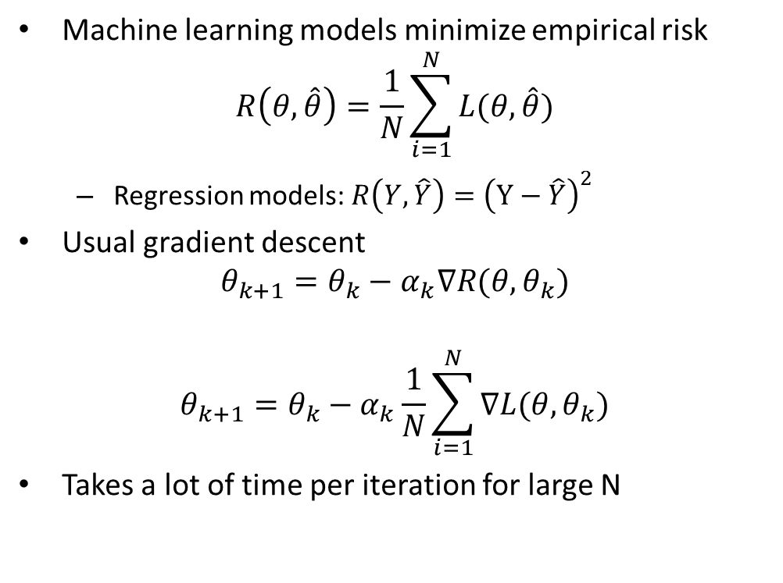
Stochastic gradient descent
Machine learning models minimize empirical risk
$$R\left(θ,\hat{θ}\right)=\frac{1}{N}\sum_{i=1}^{N}{L(θ,\hat{θ})}$$
Regression models: $R\left(Y, \hat{Y}\right)={\left(Y−\hat{Y}\right)}^{2}$
Usual gradient descent
$$θ_{k+1}=θ_{k}−α_{k}∇R(θ,θ_{k})$$
$$θ_{k+1}=θ_{k}−α_{k}\frac{1}{N}\sum_{i=1}^{N}{∇L(θ,θ_{k})}$$
Takes a lot of time per iteration for large N

Slide 15
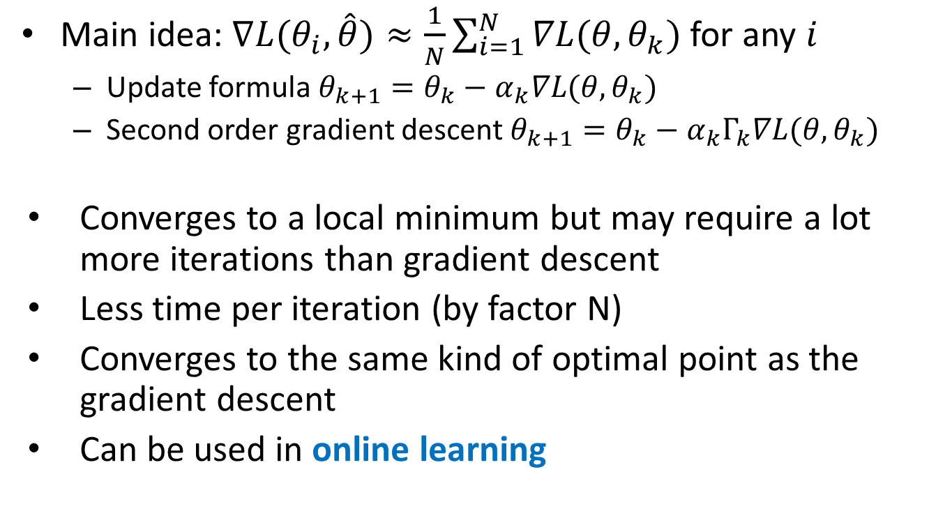
Stochastic gradient descent
Main idea: $∇L(θ_{i},\hat{θ})≈\frac{1}{N}\sum_{i=1}^{N}{∇L(θ,θ_{k})}$ for any $i$
Update formula $θ_{k+1}=θ_{k}−α_{k}∇L(θ,θ_{k})$
Second order gradient descent $θ_{k+1}=θ_{k}−α_{k}Γ_{k}∇L(θ,θ_{k})$
Converges to a local minimum but may require a lot more iterations than gradient descent
Less time per iteration (by factor N)
Converges to the same kind of optimal point as the gradient descent
Can be used in online learning

Slide 16
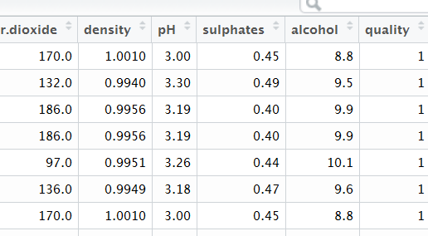
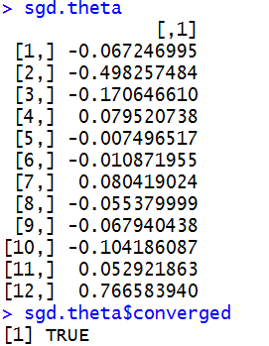
Stochastic gradient descent
Use package sgd in R:
Linear model, GLM, Cox model,…
sgd.theta <- sgd(quality ~ ., data=dat,
model="glm", model.control=binomial(link="logit"),
sgd.control=list(reltol=1e-5, npasses=200))
sgd.theta

Slide 17
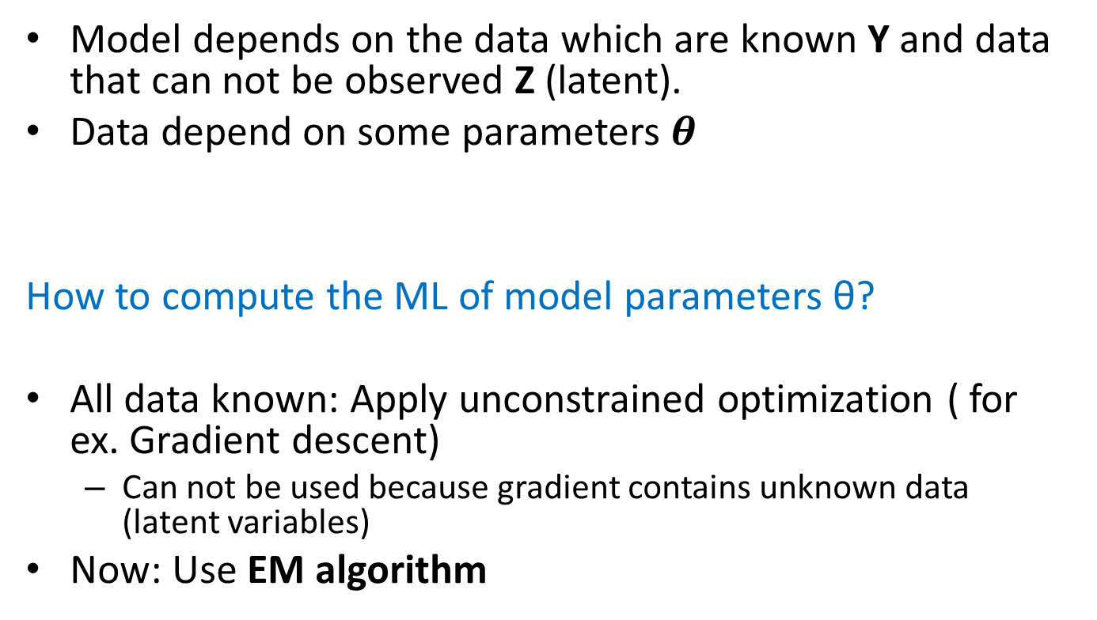
EM algorithm
Model depends on the data which are known Y and data that can not be observed Z (latent).
Data depend on some parameters $θ$
How to compute the ML of model parameters θ?
All data known: Apply unconstrained optimization ( for ex. Gradient descent)
Can not be used because gradient contains unknown data (latent variables)
Now: Use EM algorithm

Slide 18
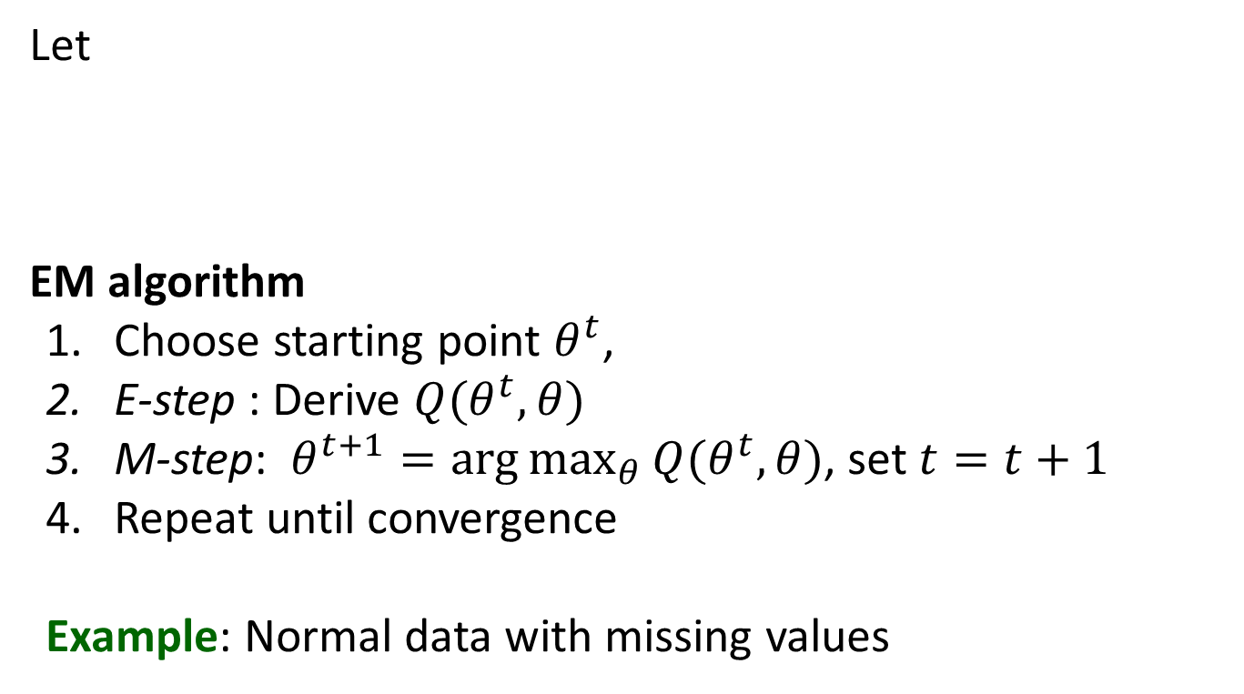
EM algorithm
Let
EM algorithm
Choose starting point $θ^{t}$,
E-step : Derive $Q(θ^{t},θ)$
M-step: $θ^{t+1}=\arg{\max_{θ}{Q(θ^{t},θ)}}$, set $t=t+1$
Repeat until convergence
Example: Normal data with missing values

Slide 19
R: EM Algorithm
Example: Normal data with some missing observations
em.norm <- function(Y){
Yobs <- Y[!is.na(Y)]
Ymiss <- Y[is.na(Y)]
n <- length(c(Yobs, Ymiss))
r <- length(Yobs)
# Initial values
mut <- 1
sit <- 0.1
# Define log-likelihood function
ll <- function(y, mu, sigma2, n){
-0.5*n*log(2*pi*sigma2)-0.5*sum((y-mu)^2)/sigma2
}
# Compute the log-likelihood for the initial values
lltm1 <- ll(Yobs, mut, sit, n)

Slide 20
R: EM Algorithm
Example: Normal data with some missing observations
repeat{
# E-step
EY <- sum(Yobs) + (n-r)*mut
EY2 <- sum(Yobs^2) + (n-r)*(mut^2 + sit)
# M-step
mut1 <- EY / n
sit1 <- EY2 / n - mut1^2
# Update parameter values
mut <- mut1
sit <- sit1
# Compute log-likelihood using current estimates
llt <- ll(Yobs, mut, sit, n)
# Print current parameter values and likelihood
cat(mut, sit, llt, "\n")
# Stop if converged
if ( abs(lltm1 - llt) < 0.001) break
lltm1 <- llt
}
}

Slide 21
R: EM Algorithm
Example: Normal data with some missing observations
# Generate complete data N(5,1) and set 5 last as missing values
x <- rnorm(20,5)
x[16:20] <- NA
# Run the EM-algorithm function
em.norm(x)
3.856777 3.279395 -33.95757
4.570972 1.523877 -26.37452
4.74952 0.9255991 -23.4036
4.794157 0.7660673 -22.6868
4.805317 0.7255617 -22.53068
4.808106 0.7153964 -22.49403
4.808804 0.7128526 -22.48504
4.808978 0.7122165 -22.4828
4.809022 0.7120575 -22.48225
# Note that the function only generates parameter values

Slide 22
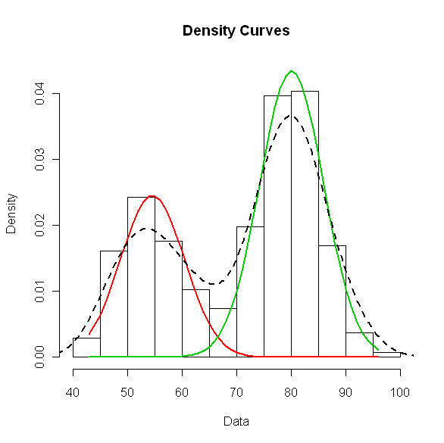
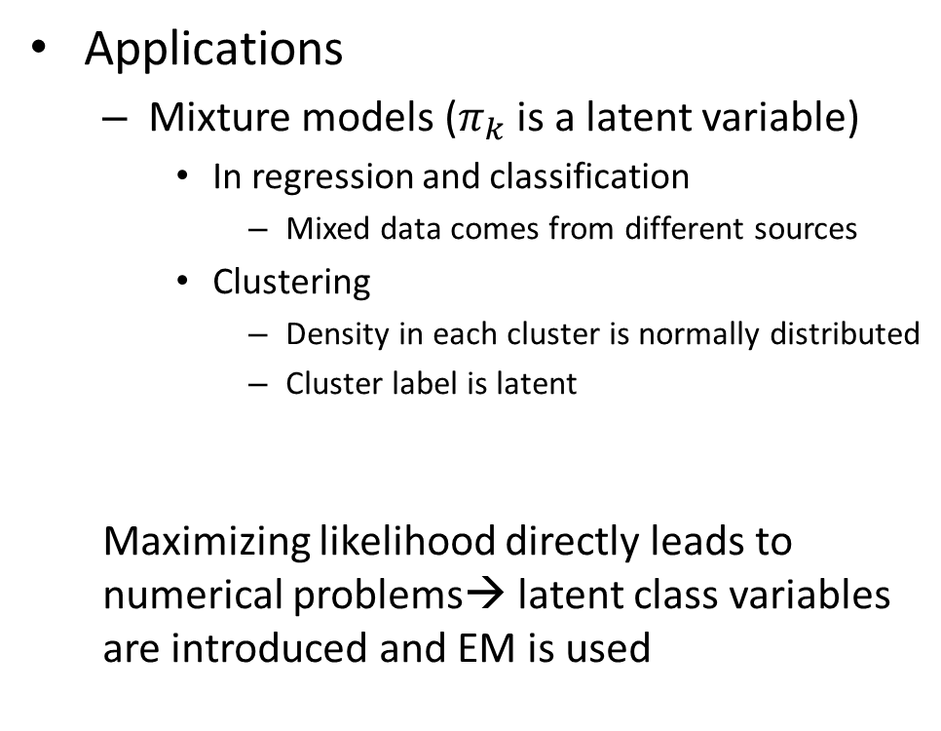
EM algorithm
Applications
Mixture models ($π_{k}$ is a latent variable)
In regression and classification
Mixed data comes from different sources
Clustering
Density in each cluster is normally distributed
Cluster label is latent
Maximizing likelihood directly leads to numerical problems→ latent class variables are introduced and EM is used

Slide 23
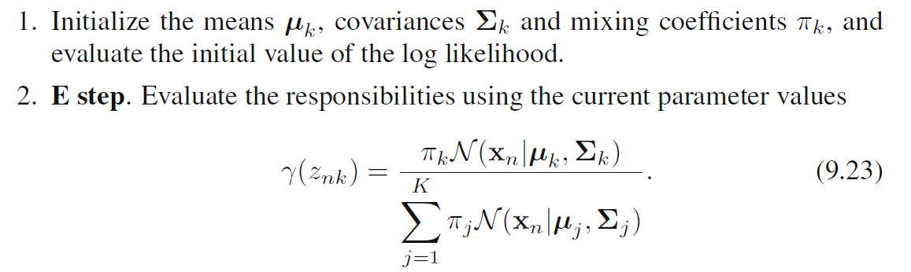
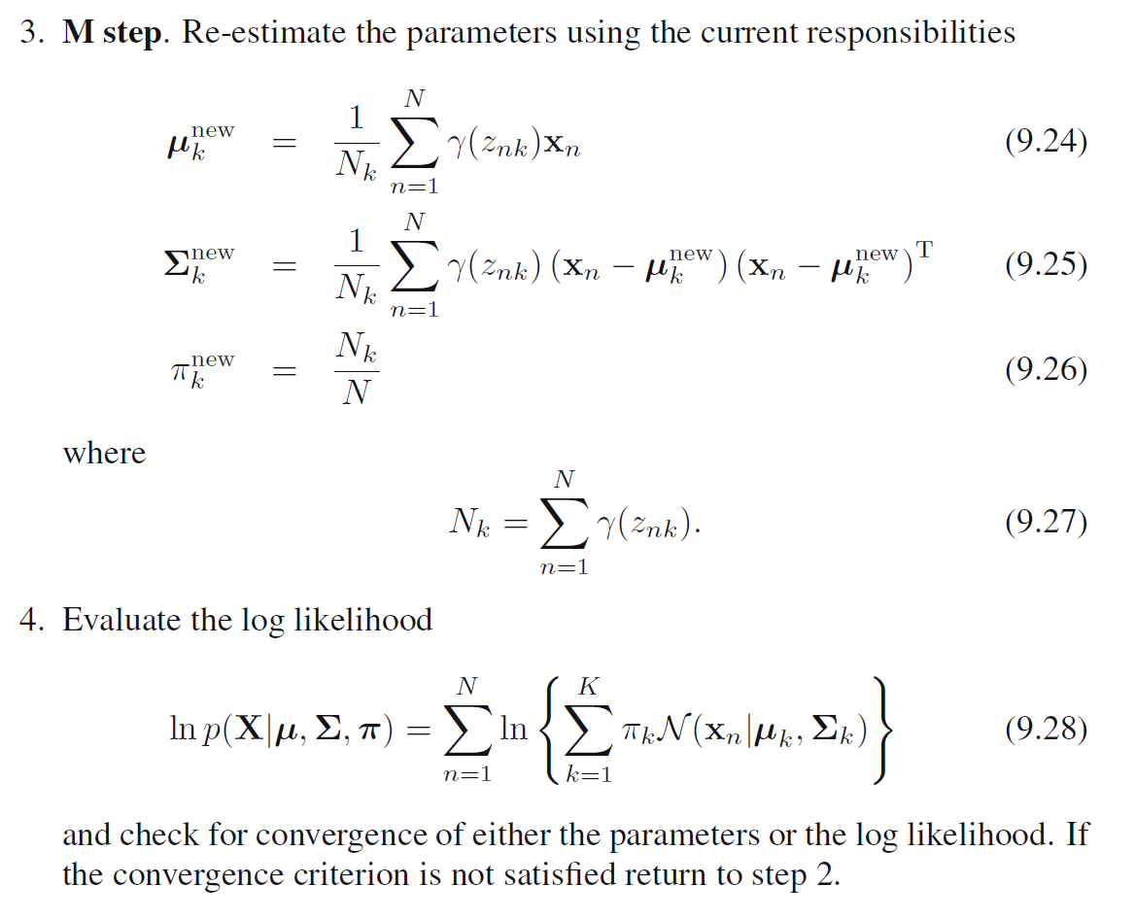

EM algorithm for gaussian mixtures
$$Ez_{nk}=γ(z_{nk})$$
Source: Pattern recognition by Bishop

